Slide 1


Slide 2


CRITICAL REASONING MIMIC THE PATTERN

Slide 3
Concepts:
Critical reasoning mimic the pattern:
In this one is supposed to pick the choice, which is same as the flow/logic of the reasoning in the question.
It is the process of manipulating one's mental image of an object in order to reach a certain conclusion.

Slide 4
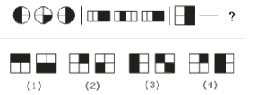
Question 01:
Look carefully at the sequence of symbols to find the pattern. Choose the correct pattern:
1
2
3
4
Answer: D

Slide 5
Explanation:
In each of the segments, the figures alternate between one-half and one-fourth shaded.

Slide 6

Question 02:
Choose the correct pattern:
1
2
3
4
Answer: C

Slide 7
Explanation:
In the first segment, two letters face right and the next two face left. The first letter in the second segment repeats the last letter of the previous segment. The same is true for the third segment. But the forth segment changes again; it is the opposite of the first segment, so the last two letters must face right.

Slide 8

Question 03:
Choose the correct pattern:
1
2
3
4
Answer: A

Slide 9
Explanation:
In this series, the figures increase the amount of shading by one-fourth and, once a square is completely shaded, starts over with an unshaded square. In the second segment, you will notice that the figure goes from completely shaded to completely unshaded. This is why choice a is the correct choice.

Slide 10
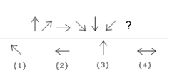
Question 04:
Choose the correct pattern:
1
2
3
4
Answer: B

Slide 11
Explanation:
Each arrow in this continuing series moves a few degrees in a clockwise direction. Think of these arrows as the big hand on a clock. The first arrow is at noon. The last arrow before the blank would be 12:40. Choice b, the correct answer, is at 12:45.

Slide 12
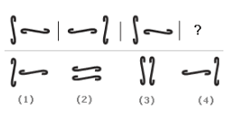
Question 05:
Choose the correct pattern:
1
2
3
4
Answer: D

Slide 13
Explanation:
Look for opposites in this series of figures. The first and second segments are opposites of each other. The same is true for the third and fourth segments.

Slide 14
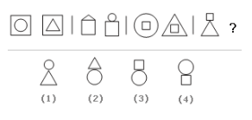
Question 06:
Choose the correct pattern:
1
2
3
4
Answer: C

Slide 15
Explanation:
All four segments use the same figures: two squares, one circle, and onetriangle. In the first segment, the squares are on the outside of the circle and triangle. In the second segment, the squares are below the other two. In the third segment, the squares on are the inside. In the fourth segment, the squares are above the triangle and circle.

Slide 16

Question 07:
Choose the correct pattern:
1
2
3
4
Answer: C

Slide 17
Explanation:
In this series, the shaded part inside the circle gets larger and then smaller.

Slide 18

Question 08:
Choose the correct pattern:
1
2
3
4
Answer: B

Slide 19
Explanation:
Look at each segment. In the first segment, the arrows are both pointing to the right. In the second segment, the first arrow is up and the second is down. The third segment repeats the first segment. In the fourth segment, the arrows are up and then down. Because this is an alternating series,the two arrows pointing right will be repeated, so option b is the only possible choice.
Notes:
.

Slide 20
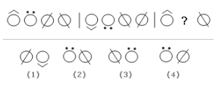
Question 09:
Choose the correct pattern:
1
2
3
4
Answer: D

Slide 21
Explanation:
This is an alternating series. The first and third segments are repeated. The second segment is simply upside down.

Slide 22

Question 10:
Choose the correct pattern:
1
2
3
4
Answer: C

Slide 23
Explanation:
This is an alternating series. In the first segment, the letter "E" faces right, then down, then right. In the second segment, the letters all face down. To follow this pattern, in the fourth segment, the letters must all face up.

Slide 24
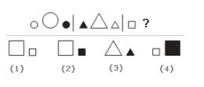
Question 11:
Choose the correct pattern:
1
2
3
4
Answer: B

Slide 25
Explanation:
Notice that in each segment, the figures are all the same shape, but the one in the middle is larger than the two on either side. Also, notice that one of the figures is shaded and that this shading alternates first right and then left. To continue this pattern in the third segment, you will look for a square. Choice b is correct because this choice will put the large square between the two smaller squares, with the shading on the right.

Slide 26

Question 12:
Choose the correct pattern:
1
2
3
4
Answer: A

Slide 27
Explanation:
Look at each segment. You will notice that in each, the figure on the right and the figure on the left are the same; the figure in between is different. To continue this pattern in the last segment, the diamond on the left will be repeated on the right. Choice a is the only possible answer.

Slide 28

Question 13:
Choose the correct pattern:
1
2
3
4
Answer: D

Slide 29
Explanation:
This sequence concerns the number of sides on each figure. In the first segment, the three figures have one side, and then two sides, and then three sides. In the second segment, the number of sides increases and then decreases. In the third segment, the number of sides continues to decrease.

Slide 30
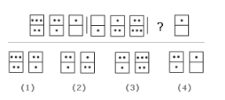
Question 14:
Choose the correct pattern:
1
2
3
4
Answer: A

Slide 31
Explanation:
Look carefully at the number of dots in each domino. The first segment goes from five to three to one. The second segment goes from one to three to five. The third segment repeats the first segment.

Slide 32
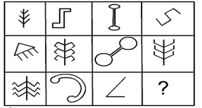

Question 15:
Find missing pattern:
Answer: D

Slide 33
Explanation:
All the figures provided in the options are present in the 'collection' except for D which at first sight might seem similar to the figure in the first column-second row object, but close examination would reveal that it has 5 teeth instead of 4 teeth present in the afore-mentioned figure belonging to the collection.

